Slide 1
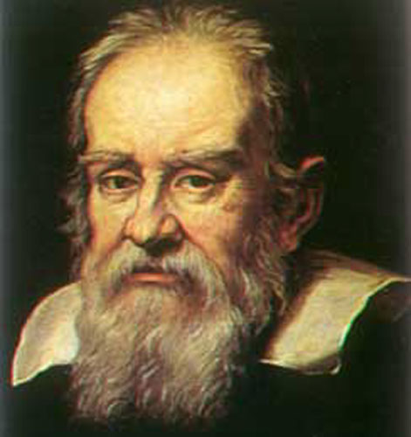
Galileo Galilei:
Astro Chapter 3-4

Slide 2
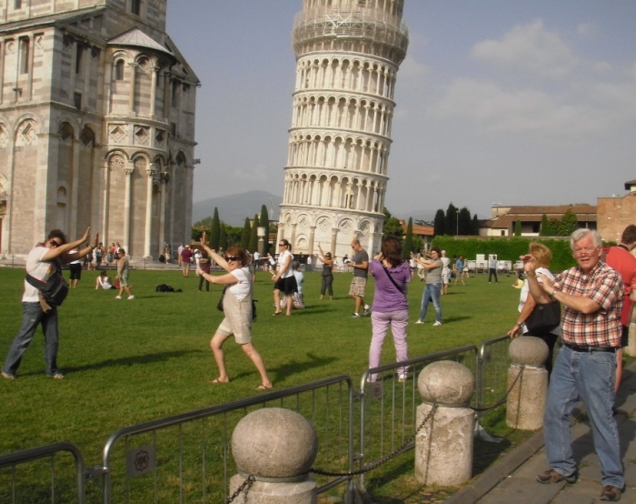
Born 1564 in Pisa, Italy
Studied medicine at the university in Pisa

Slide 3
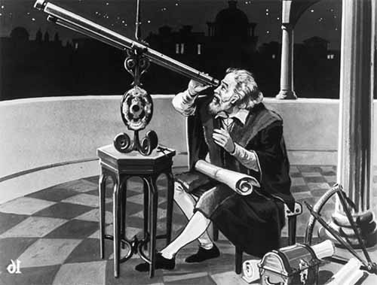
Loved math and was professor of math at the university in Padua for 18 years
Built a telescope in 1609, after hearing of its invention elsewhere

Slide 4
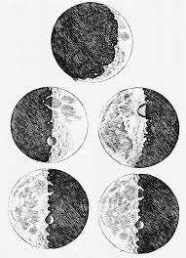
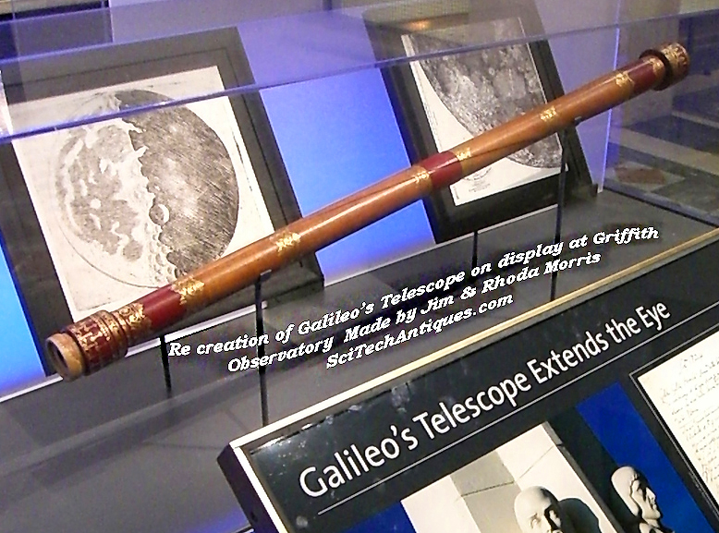
Used the telescope to carefully observe the sky
Found that the moon was not “perfect”, but had mountains and valleys

Slide 5
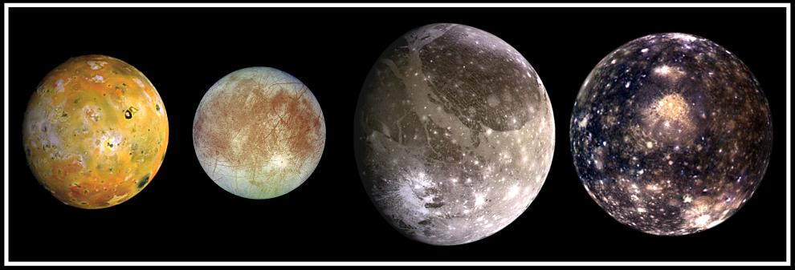
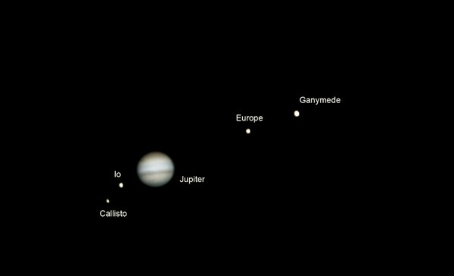
Found 4 moons orbiting Jupiter
These moons supported the Copernican model

Slide 6
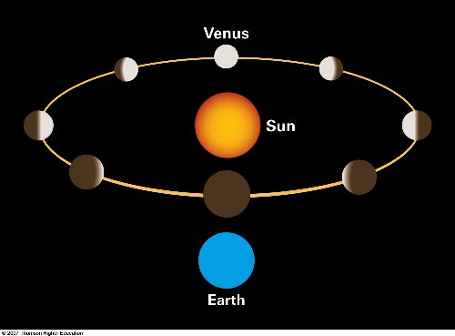
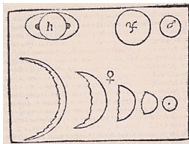
Observed phases of Venus as the sun’s shadow “moved” across it from our perspective, similar to the phases of the moon

Slide 7
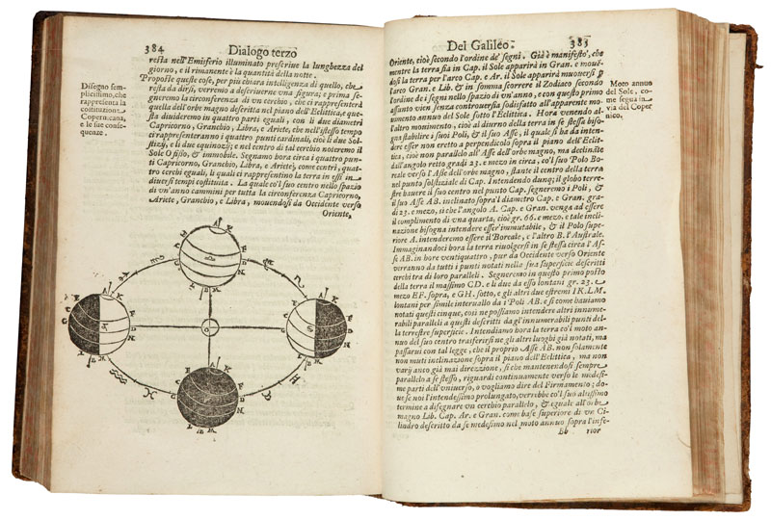
Wrote a book, Two Chief World Systems, which presented a “debate” between the Aristotle/Ptolemy model (Geocentric) and the Copernican model (Heliocentric)

Slide 8
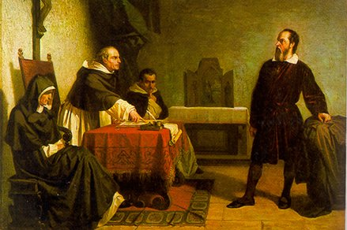
Was tried and convicted by the Inquisistion for heresy and disobeying the order to cease debating between the two models, because of the conflict with religious views

Slide 9
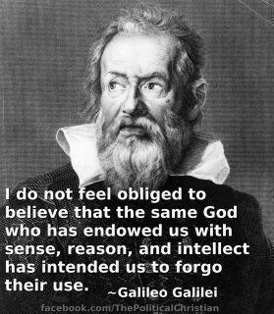
Died in 1642 still holding to his Copernican view of the universe

